Slide 1






What is a model?
Christopher Summerfield
University of Oxford
BAMB! Summer School 2023
funding
Notes:
Thank you all for coming, it’s a particular pleasure to be here at NYU.
Much of the work that I’m going to describe has been directly inspired by ideas which were first developed here.

Slide 2



Models
Models are simulations (in computer code) of natural phenomena
Global finance
Language (LLMs) Weather Forecasting
Structural Biology (e.g. Protein Folding)
Chess Computers
Ideal Gas Laws
etc

Slide 3

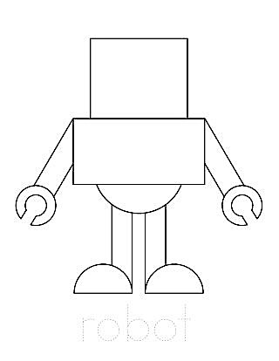

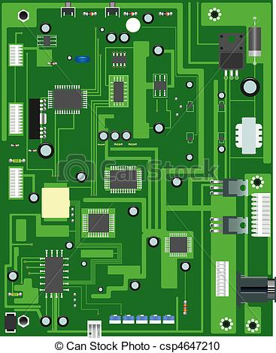
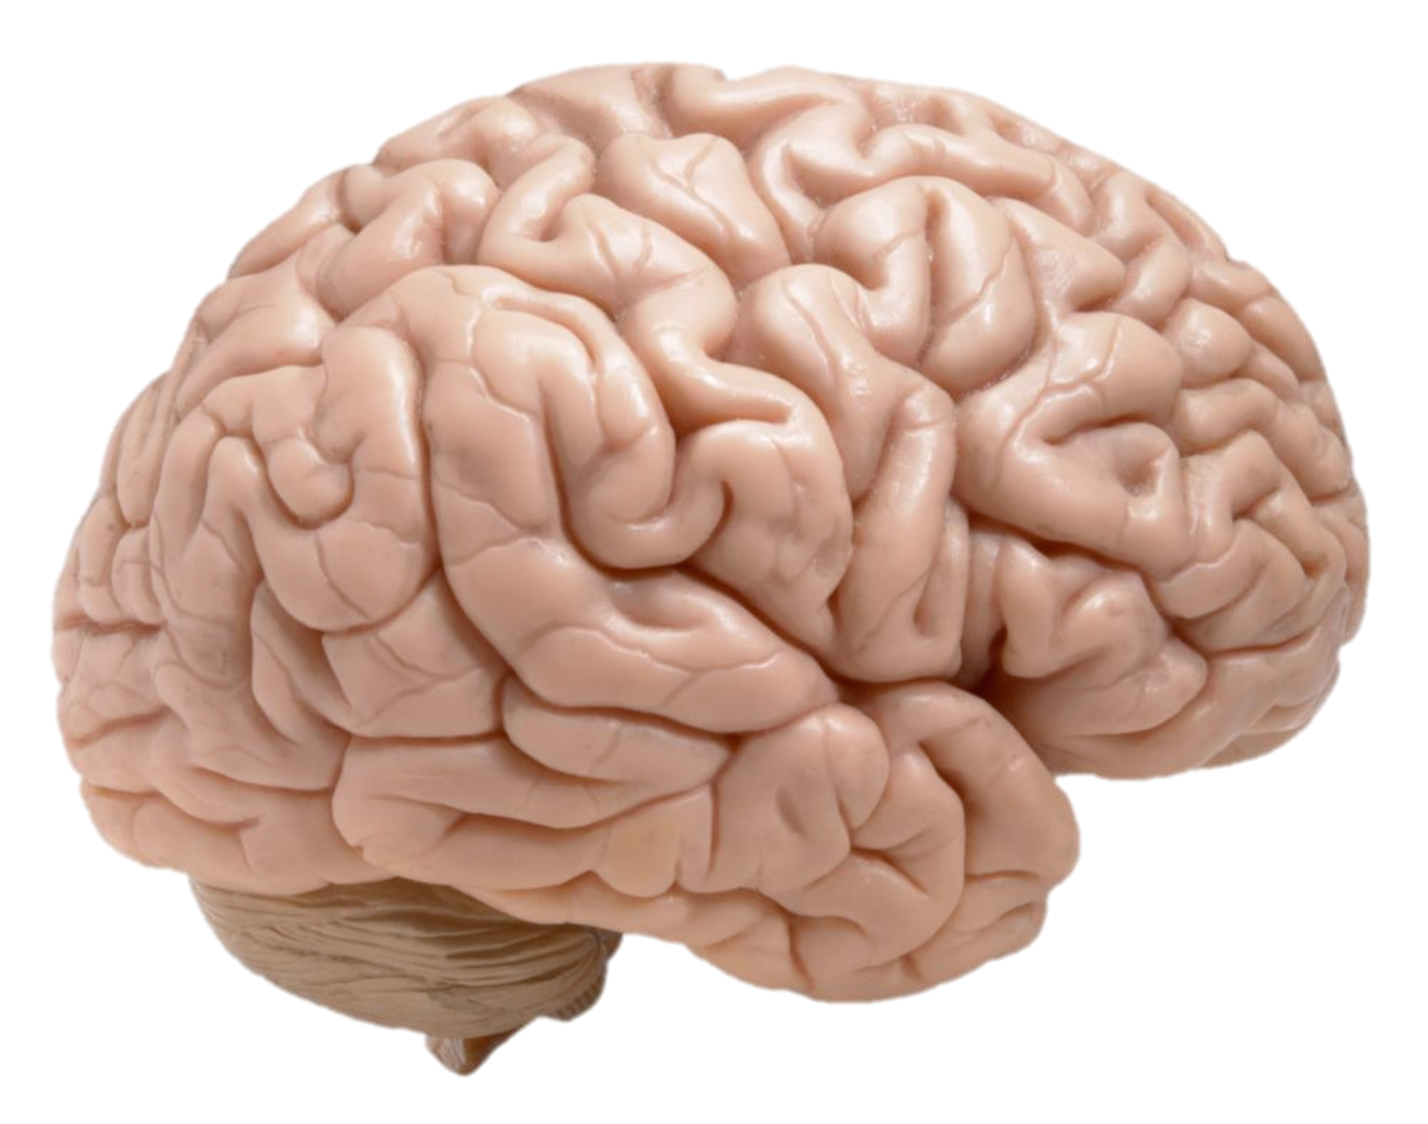
Outline
Engineering the brain
Reverse engineering the brain
Artificial Intelligence: to build intelligent information processing systems in silico
Machine Learning: to use statistical principles to optimize information processing systems
Psychology: to understand the organisation of behavior and its foundations in cognition
Neuroscience: to understand neural coding and computation, and localise brain function

Slide 4
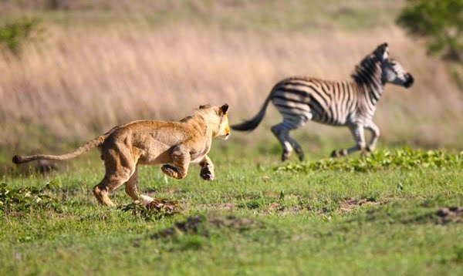
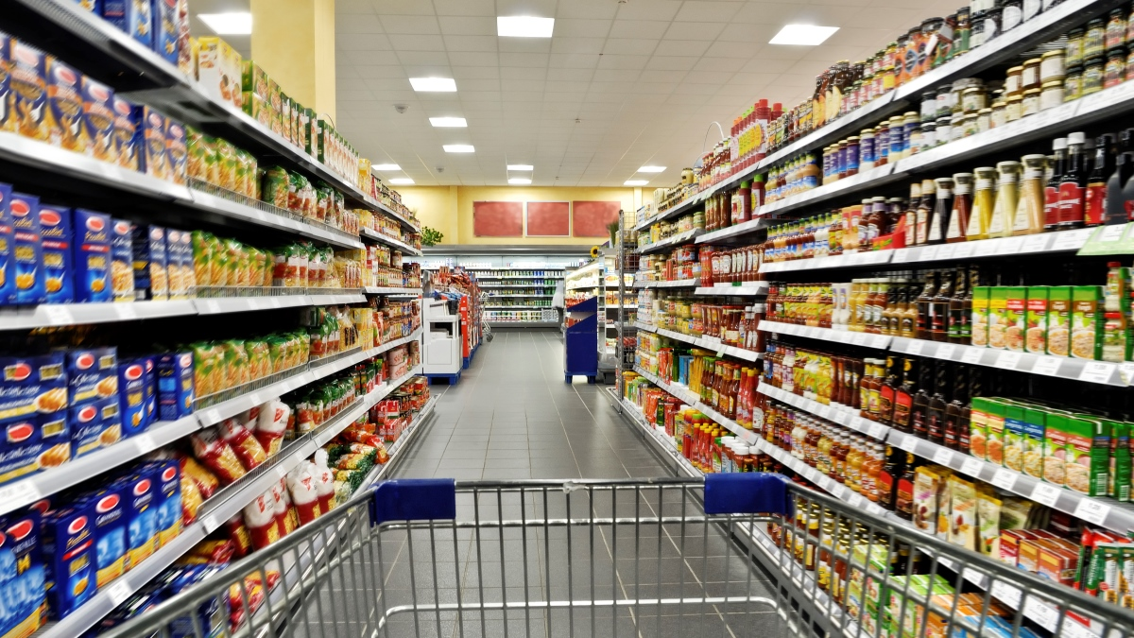




Why are we here?
predator-prey interactions
consumer behavior
mind / brain
social group dynamics
global finance
education
mental health

Slide 5
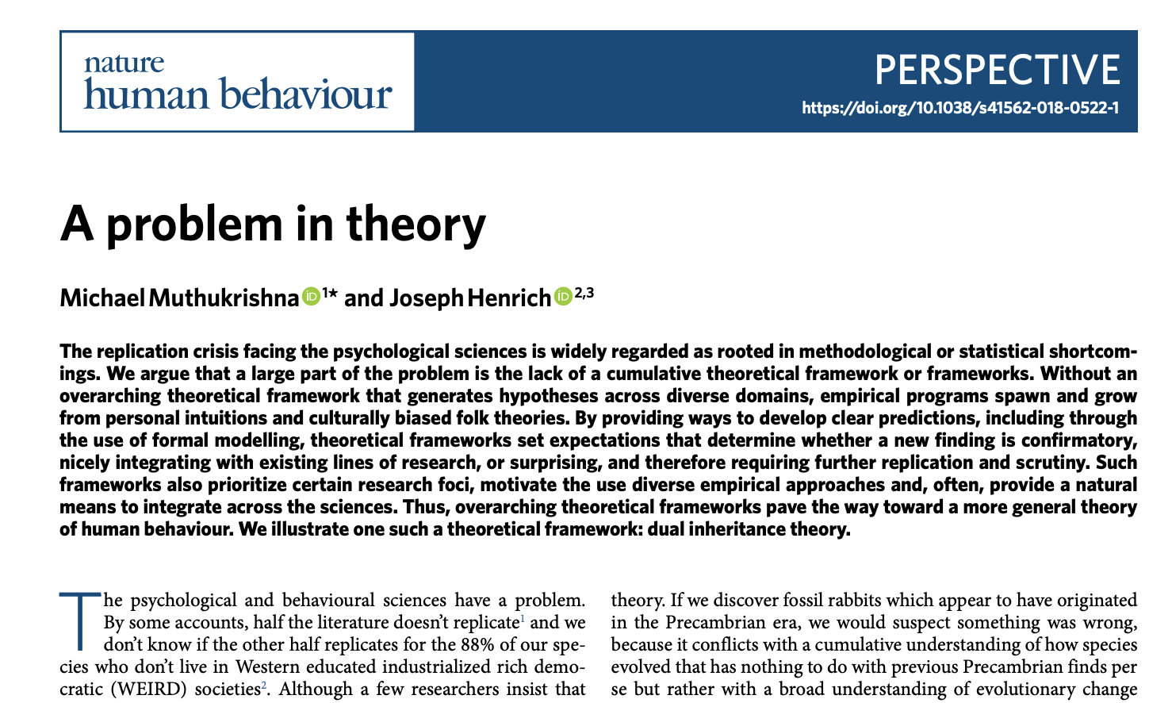
A problem in theory
“Many subfields within psychology…lack any overarching, integrative general theoretical framework that would allow researchers to derive specific predictions from more general premises”
“Rather than building up principles that flow from overarching theoretical frameworks, psychology textbooks are largely a potpourri of disconnected empirical findings on topics that have been popular at some point in the discipline’s history, and clustered based on largely American and European folk categories"
Notes:
Thank you all for coming, it’s a particular pleasure to be here at NYU.
Much of the work that I’m going to describe has been directly inspired by ideas which were first developed here.

Slide 6



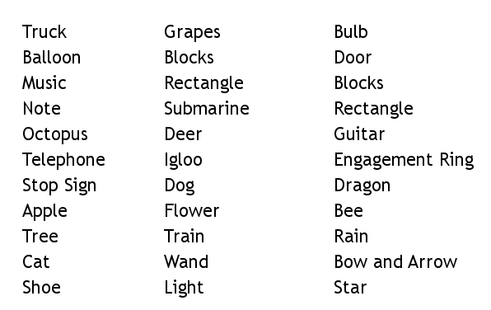
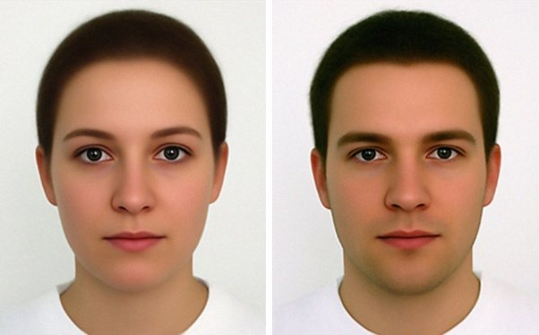
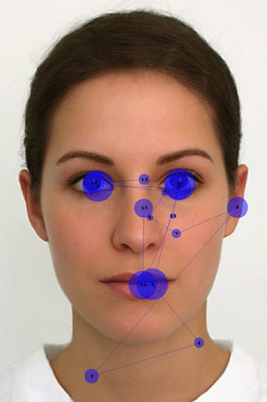
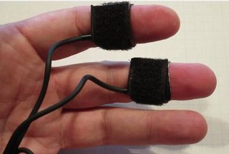
The information processing approach
mind / brain
stimulation
behaviour
?
[model]
input
(known)
computation
(unobservable)
output
(measured)

Slide 7
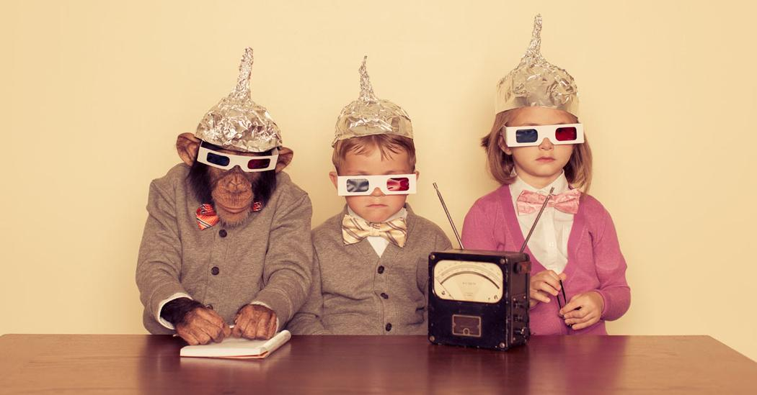
Interventions

Slide 8
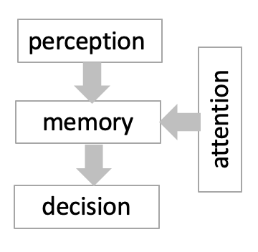
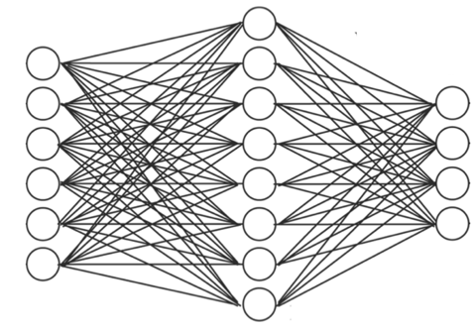
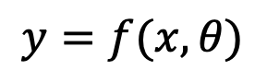
The information processing approach
mind / brain
stimulation
behaviour
$$y=f(x,θ)$$
input
(known)
model
(inferred)
output
(measured)

Slide 9
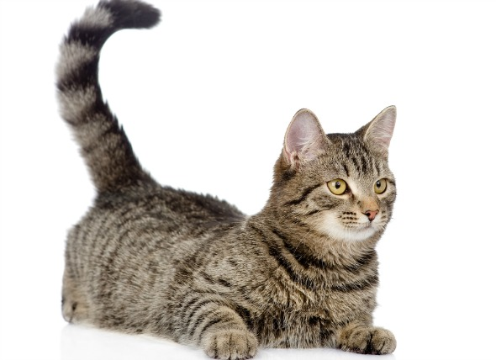

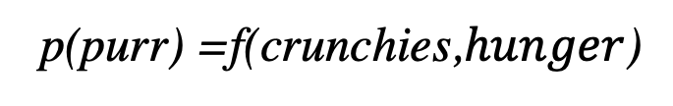
What is a model?
ground truth
simulated (comp. neuro/cog. sci)
simulated
(same cat)
p(purr) =f(crunchies,$hunger$)
crunchies
CPU
(Cat Processing Unit)
purr
simulated
(robotics)
dog
run
simulated (psychology)
“The best model of a cat is another cat, or preferably the same cat”
Norbert Weiner, Founder of Cybernetics

Slide 10
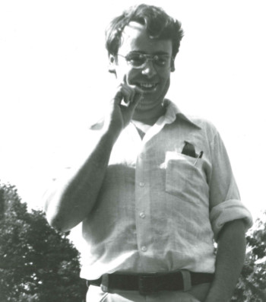
Levels of description
Marr

Slide 11
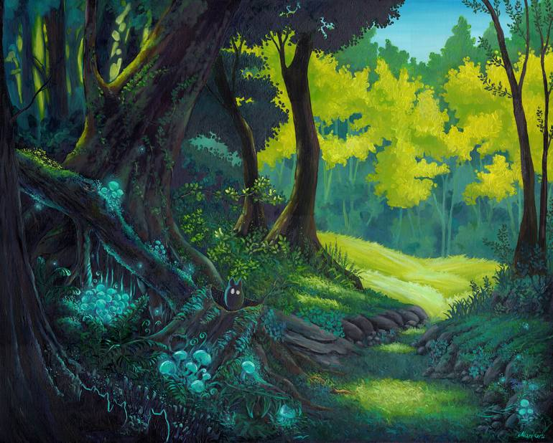

Approaches
Ecological approach
Accounts for natural environment
Naturalistic tasks
Less constrained models
Data harder to interpret
e.g. study attention during driving simulation
Artificial approach
Overlooks natural environment
Contrived tasks
Well-constrained models
Data easier to interpret
e.g. study attention in the lab

Slide 12
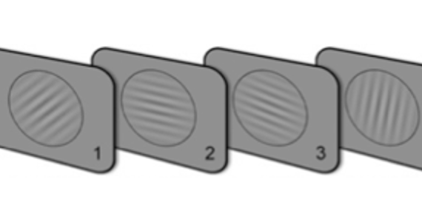

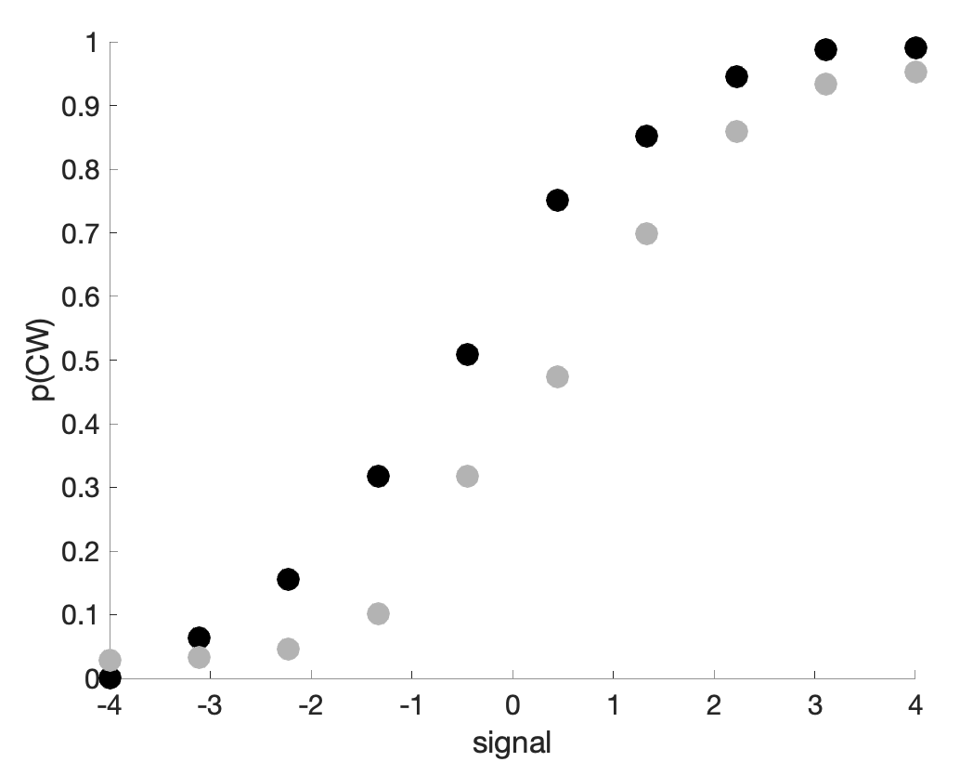
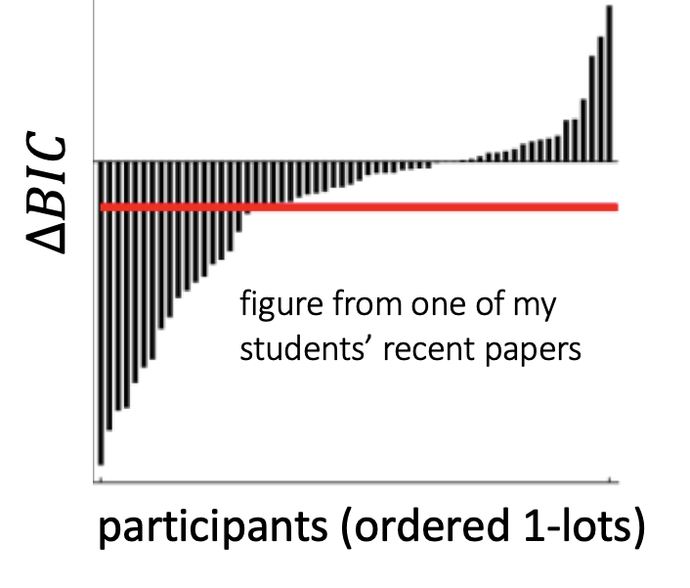
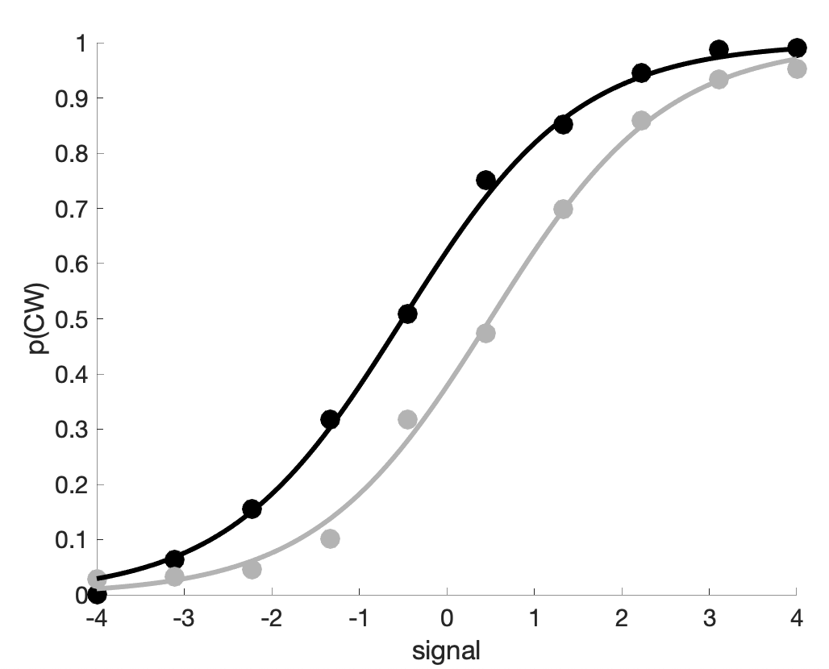
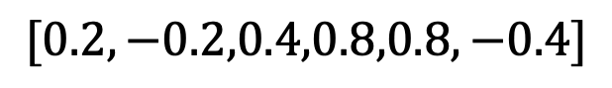
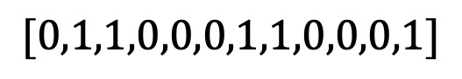
Model fitting: the basics
signals
$$[0.2,−0.2,0.4,0.8,0.8,−0.4]$$
choices
$$[0,1,1,0,0,0,1,1,0,0,0,1]$$
participants
stimuli
raw data
summaries
model fits
simulations

Slide 13

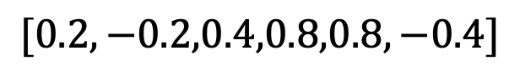
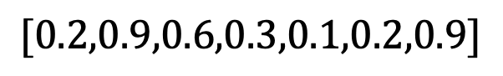
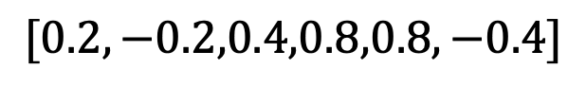
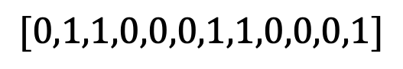
Model fitting: the basics
signals
$$[0.2,−0.2,0.4,0.8,0.8,−0.4]$$
choices
$$[0,1,1,0,0,0,1,1,0,0,0,1]$$
model
raw data
signals
$$[0.2,−0.2,0.4,0.8,0.8,−0.4]$$
choice probabilities
$$[0.2,0.9,0.6,0.3,0.1,0.2,0.9]$$
predicted data

Slide 14
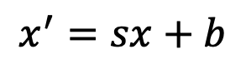
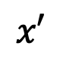
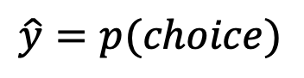
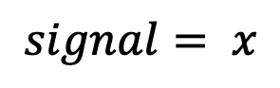
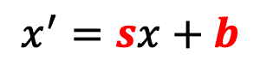
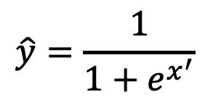
Model fitting: the basics
$$\hat{y}=\frac{1}{1+e^{x^{′}}}$$
$$\hat{y}=p(choice)$$
$$x′$$
$$x^{′}=sx+b$$
$$x^{′}=sx+b$$
$$signal= x$$

Slide 15
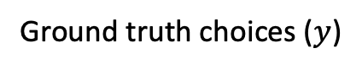
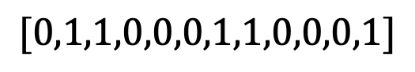
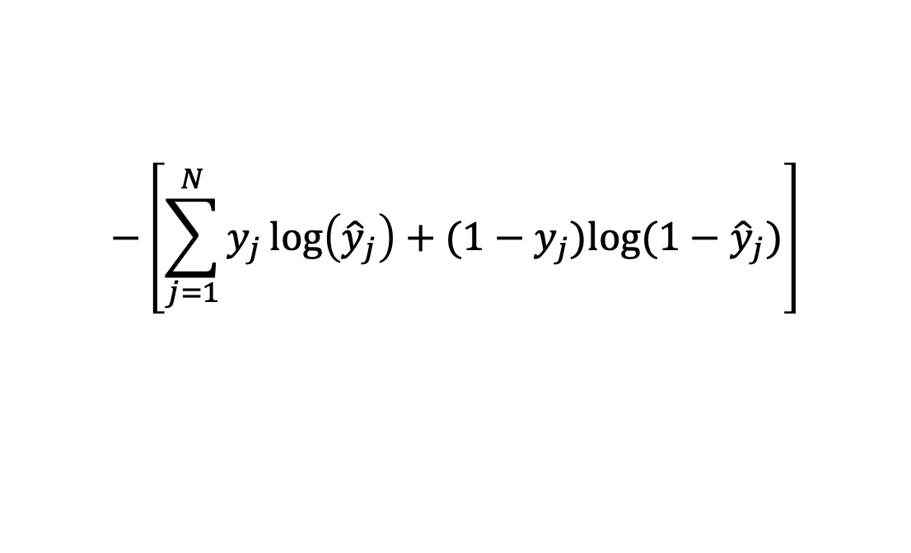
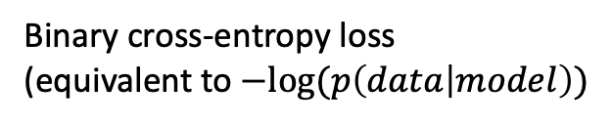
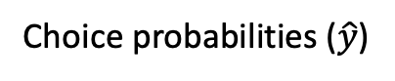
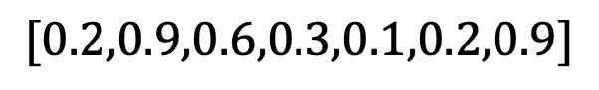
Model fitting: the basics
$$\hat{y}=\frac{1}{1+e^{x^{′}}}$$
Ground truth choices ($y$)
$$[0,1,1,0,0,0,1,1,0,0,0,1]$$
Choice probabilities ($\hat{y}$)
$$[0.2,0.9,0.6,0.3,0.1,0.2,0.9]$$
$$x′$$
$$−\left[\sum_{j=1}^{N}{y_{j}\log\left({\hat{y}}_{j}\right)+(1−y_{j}})log⁡(1−{\hat{y}}_{j})\right]$$
$$x^{′}=sx+b$$
$$signal= x$$
Binary cross-entropy loss
(equivalent to $−log⁡(p\left(data | model\right))$

Slide 16
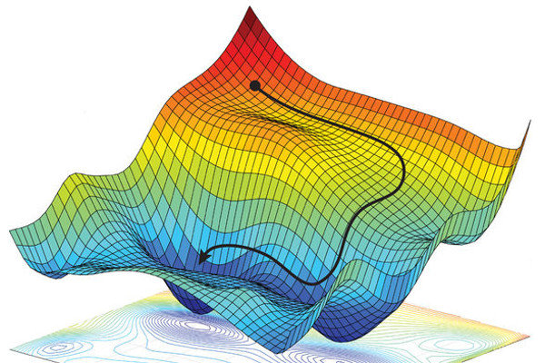
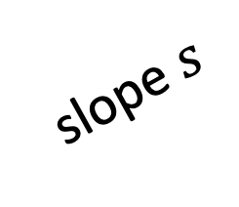
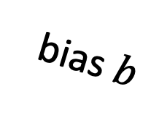
Model fitting: the basics
$$\hat{y}=\frac{1}{1+e^{x^{′}}}$$
parameter space
$$x′$$
$$x^{′}=sx+b$$
$$signal= x$$
bias $b$
slope $s$

Slide 17
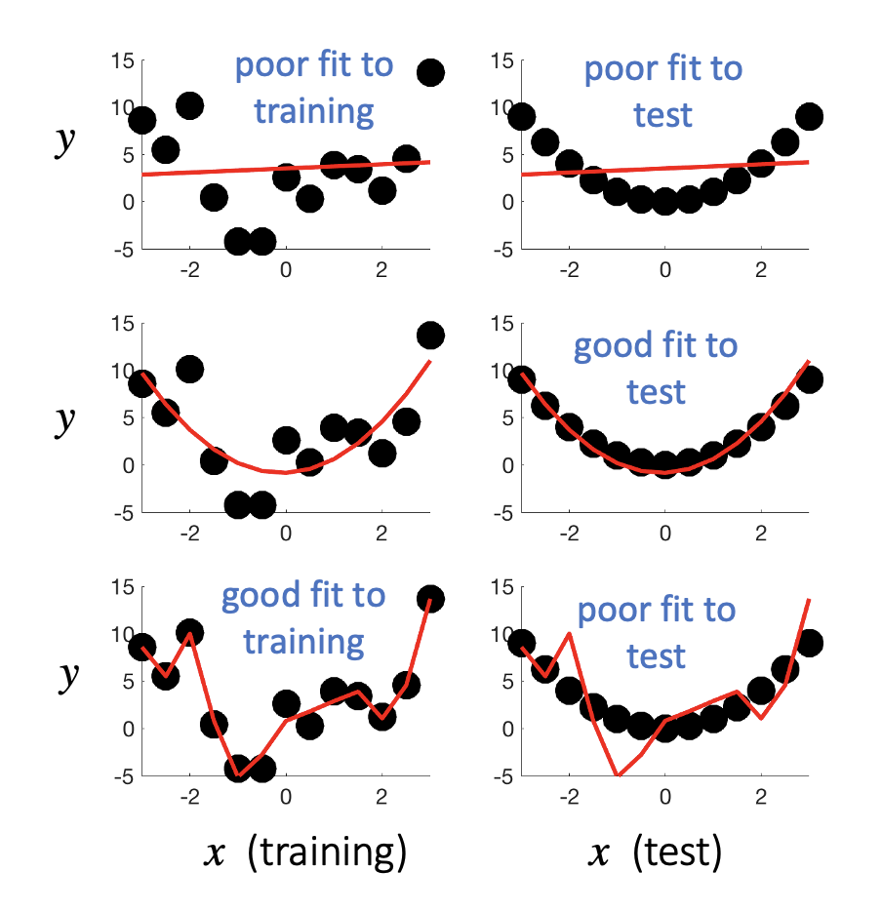
Over and underfitting
This model is underfit (high bias). It can’t capture the training or test data.
This model fits just right. It has some training error, but fits test well
This model is overfit (high variance). It captures the training data perfectly, but fails at test
Simple example of overfitting with ground truth $y=x^{2}+𝒩(0,σ)$
Notes:
Let’s begin with a question. What is really special about human intelligence? What makes us distinctive from that of other highly intelligent species, such as monkeys and birds?
Well, there are lots of anwers to this question, but in this talk I’d like to focus on one of them.

Slide 18
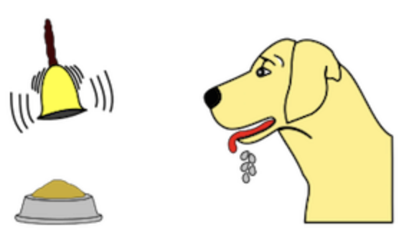

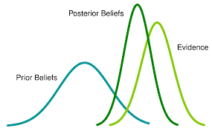

The search for a unified theory
1900
1920
1940
1960
1980
2000
2020
behaviourism
Pavlov
Watson
Skinner
connectionism
Hinton, McClelland
DiCarlo
Bayesianism
Tenebaum, Friston
cognitivism
Marr, Chomsky
Posner, Shallice

Slide 19
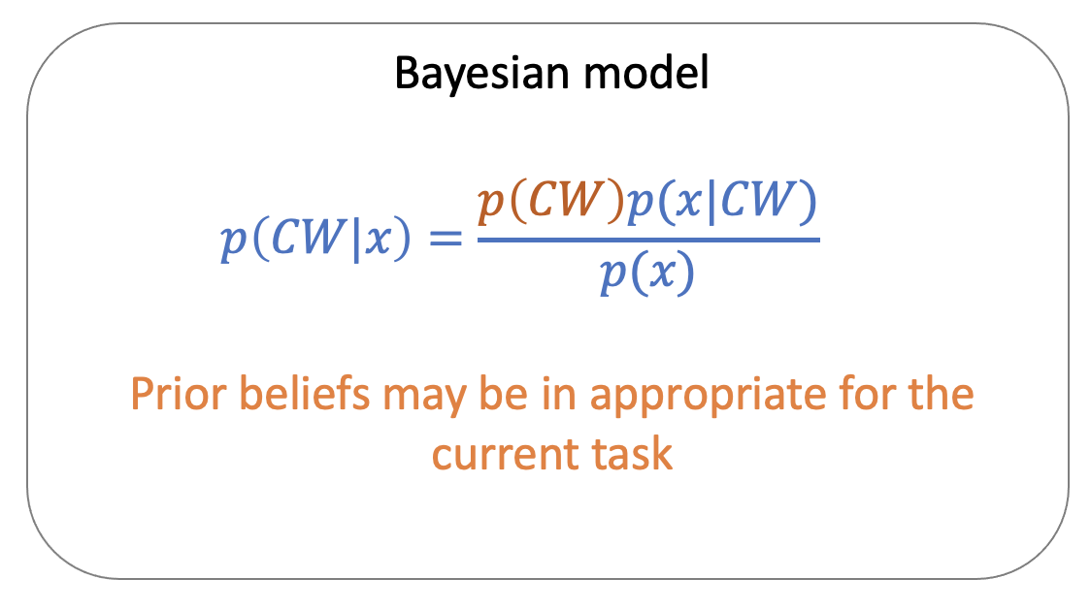
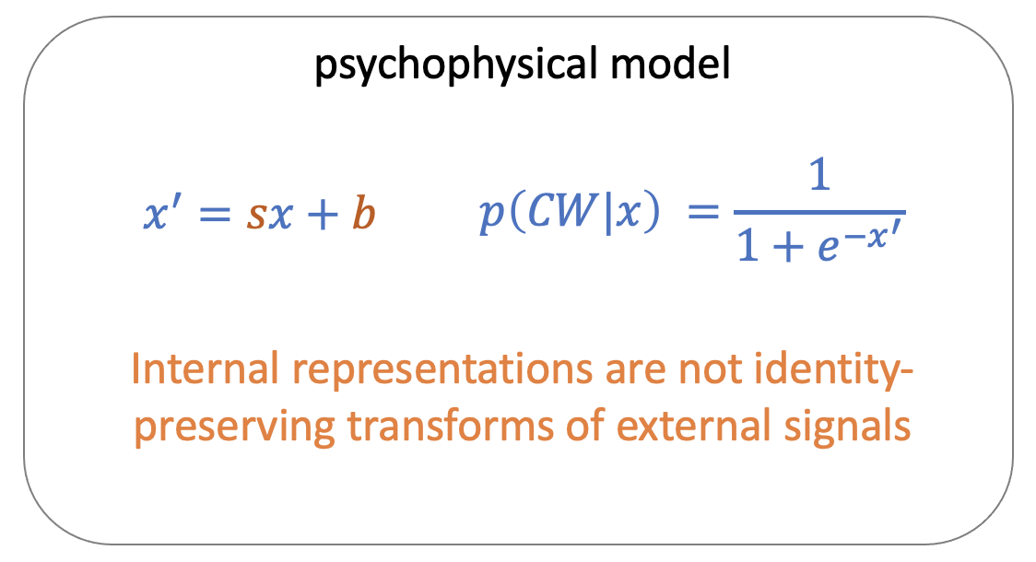
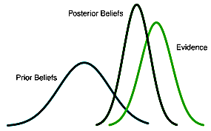
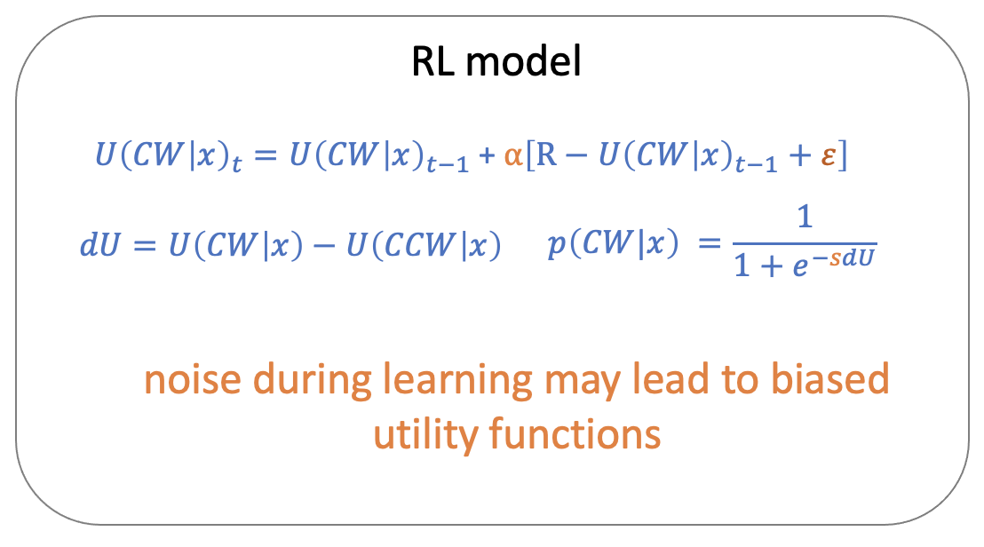


Model classes
Bayesianism
cognitivism
behaviourism
connectionism

Slide 20
What nobody teaches you
You can read thousands of papers about how to compute model evidence and compare models (and this course will help!).
what actually
happens here?
vague thoughts about cognition/computation
sit down to write model
But nobody ever tells you how to identify the space of models that you should consider in the first place.

Slide 21










Inductive biases
prior beliefs
computational constraints

Slide 22
Predicting and explaining
greater predictive power
models
Handcrafted model with a few params
Neural network with millions of parameters
greater explanatory power
Models are useful for predicting and explaining, and these two virtues typically trade off with complexity

Slide 23
Limitless models
The universe of models is theoretically limitless.
How do I know if my model space is sensible or not?
So, how do I know where to start?
D
A
C
B
space of models considered
universe of models

Slide 24

Solution 1: use past models as theories
Science is an incremental endeavour.
So, many people use a sort of mental modelling cheat sheet that involves copying what others have done.
BUT sometimes this is done without thinking very hard about why (more on this later).

Slide 25
Solution 2: take a normative stance
I have absolutely no idea how people do this task
People must be Bayesian!
I built the task, so I know the generative model. I just need to assume that people optimally invert this model for inference.
I don’t even need any free parameters!
Problem solved!
People evolved from slimy things by natural selection
Bayesian solutions are optimal
Natural selection means clever things tend to prosper
People must be optimal
People are still around, so they must be clever
Evolution has been going on for a really long time

Slide 26




Solution 3: draw inspiration from neurobiology
systems
networks
circuits
cells
synapses
There are at least 50,000 neuroscientists out there. And they know some stuff (a little, at least).
We can draw inspiration from what we know about the brain to build our models. For example, tuning curves are Gaussian, neurons are mutually inhibitory, and exhibit recurrent excitation, coding is adaptive in time and space, etc, etc.

Slide 27





Solution 4: design a cost function instead
weights
weights
cost function:
minimise classification error
minimise reconstruction error
maximise external reward
+ intrinsic costs
etc
weights
Why not forget hand-designing your model? Focus on the optimisation principle instead. If the network is powerful enough, it will learn the requisite set of computations through raw function approximation.
But….interpretability!
Marblestone et al

Slide 28


And we should be duly (but not unduly) sceptical…
Take a system that is fully understood because we built it (e.g. a microprocessor)
do cognitive neuroscience e.g. single cell recordings, brain imaging, lesion studies
Results reveals tuning curves, connectivity profiles, lesion-symptom maps and oscillatory activity just as in the real brain.
But we know that the interpretative logic applied to these phenomena is completely wrong!
Jonas & Kording 2017

Slide 29
Thanks
Over to you

